Slide 1
Avinash Yadagani
File created on: 9/14/2023 11:21:41 AM

Slide 2
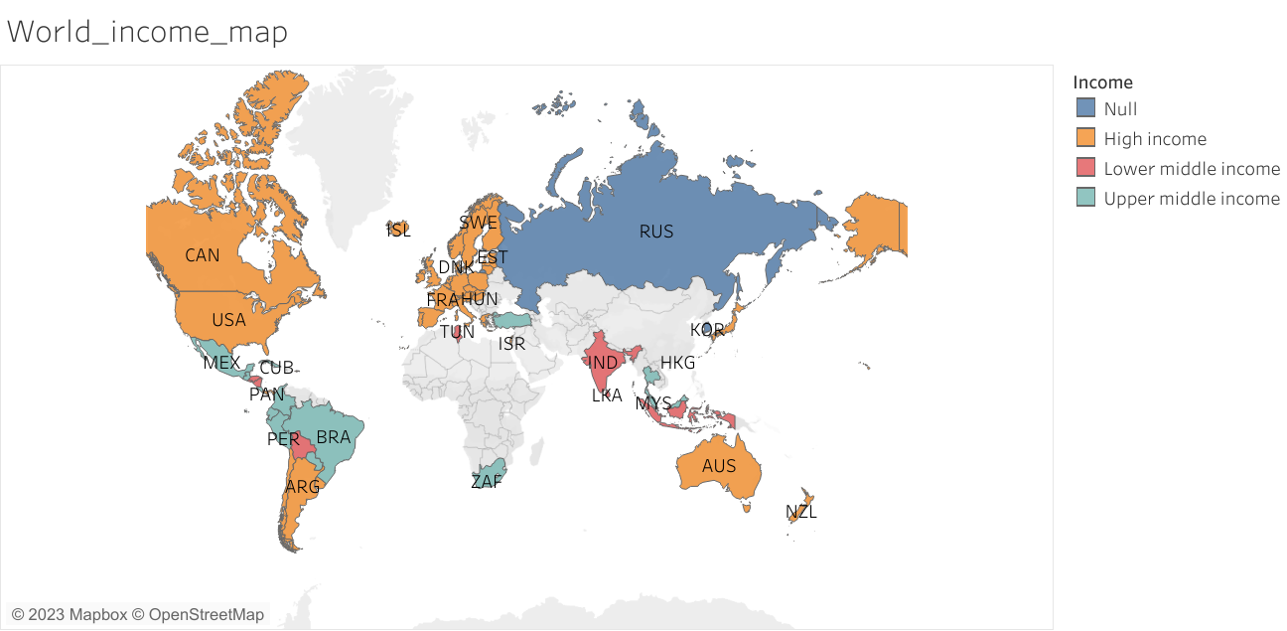

Slide 3
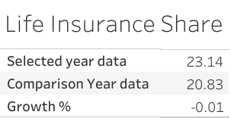

Slide 4
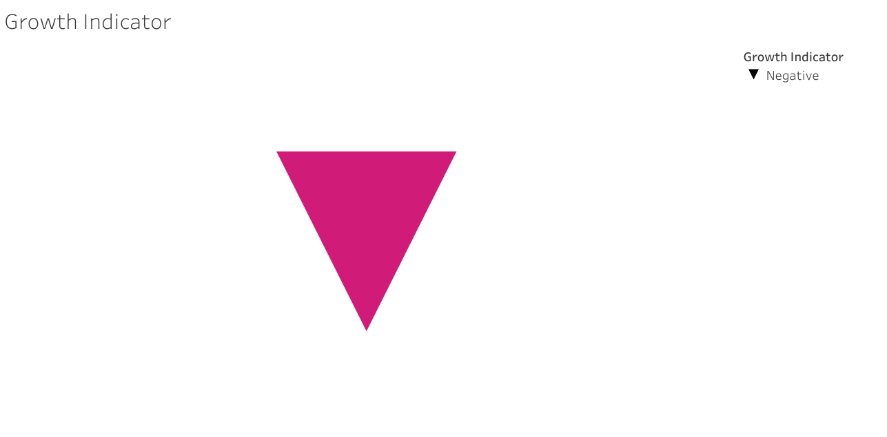

Slide 5
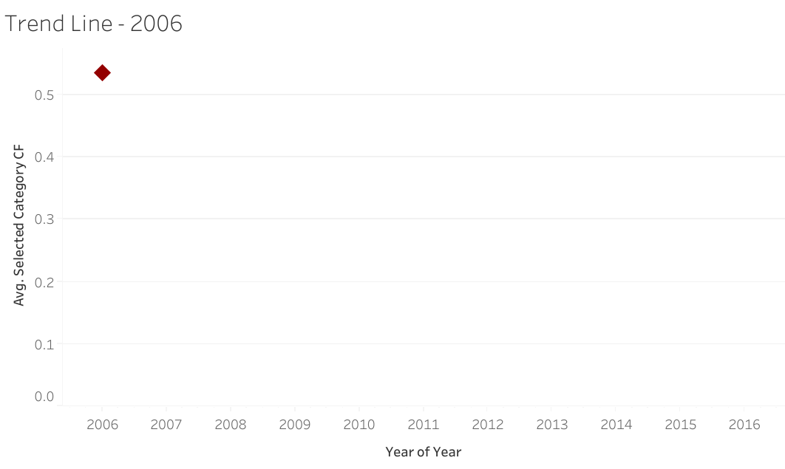

Slide 6
